Slide 1
OVERALL STRUCTURE (FOR OUR REFERENCE)
If we were game developers, what should we do?
check out the variables in our .csv file. We decide that maximizing global_sales is our primary focus.
Okay then, from the remaining variables, which ones are important?
we decide that genre, platform, publisher, critic/user scores, are important
And so we analyze these variables
This is where all the graph & models come in.
We successfully modeled publisher, platform, and genre so now we know which publisher, platform, genre to focus on.
However, we were unable to model correlation between critic/user score with global sales.
Therefore, we need to use machine learning to determine how important/how unimportant critic/user score is.
And so we do the machine learning shit
We see that there is a decent correlation → when developing our game, we should take BOTH critics’ AND users’ feedback into account
Ultimately, we know what platform, publisher, genre to choose, and that we should take users and critics feedback into account when developing a video game.

Slide 2
SC1015 GRP 9
MINI-PROJ
BY:
KIM DOBIN U2123142A
NG WEI ZHE U2122126K
LIM CHENG PING U2121712E

Slide 3
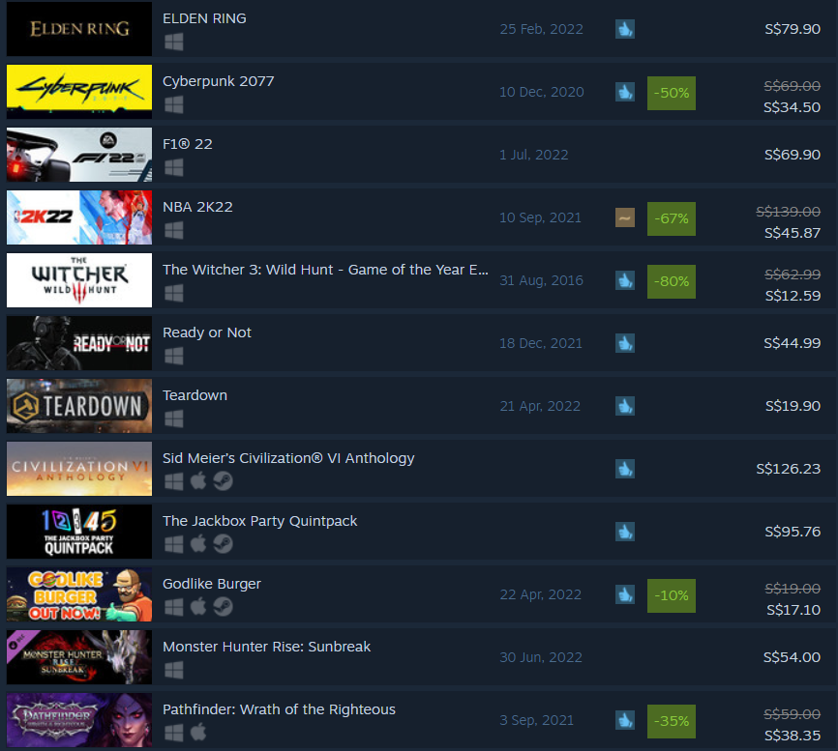
Problem Statement
Notes:
Everyone at one point of their lives are obsessed with games, playing them day and night without fail.
And for most of us, there might a time when you were waiting for a new game to release. And the game you anticipated for came out poorly, and it made you think that “even my grandma can make better games than that”. So, why not try?

Slide 4
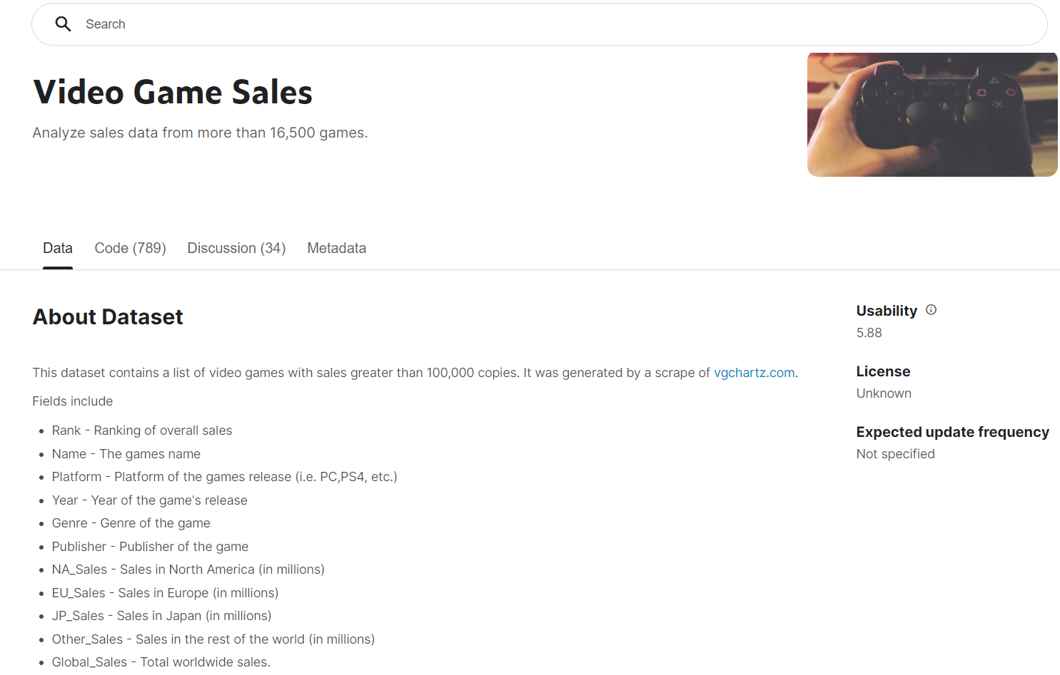
WHAT FACTORS SHOULD VIDEO GAME PRODUCERS CONSIDER TO PREDICT SALES?
DATASET
Source: https://www.kaggle.com/datasets/gregorut/videogamesales

Slide 5
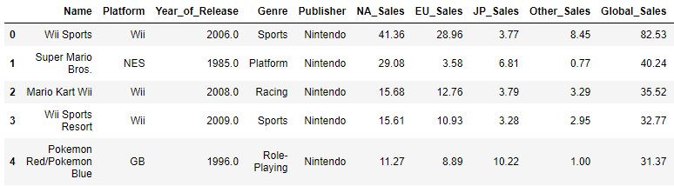
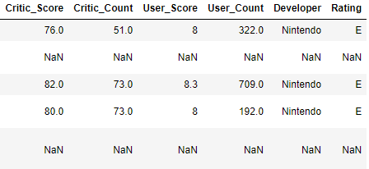
More about the dataset
Dependent Variable:
Global_Sales
Independent Variables:
Platform
Genre
Publisher
*Critic_Score
*User_Score
This is us :D
During development, focus on:
Critics’ feedback?
Users’ feedback?
Both?
Neither?

Slide 6
Plan:
Explore the relationship between: “Platform”, “Genre”, “Publisher”, “Critic_Score”, and “User_Score” with “Global Sales”
Determine characteristics of our game be like in order to maximize “Global_Sales”

Slide 7
Exploratory Analysis of Variables

Slide 8
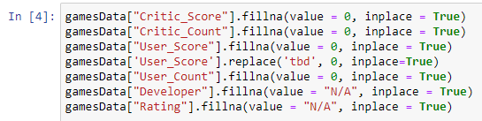
Data Preparation & Cleaning (exploratory Analysis)
Removal of games published before the year 2002
Filling empty values with ‘0’ or ‘NULL’
Conversion from Object d.type to Float

Slide 9
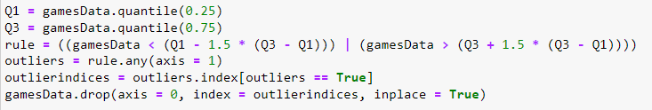
Data Preparation & Cleaning (exploratory Analysis)
4. Removing outliers

Slide 10
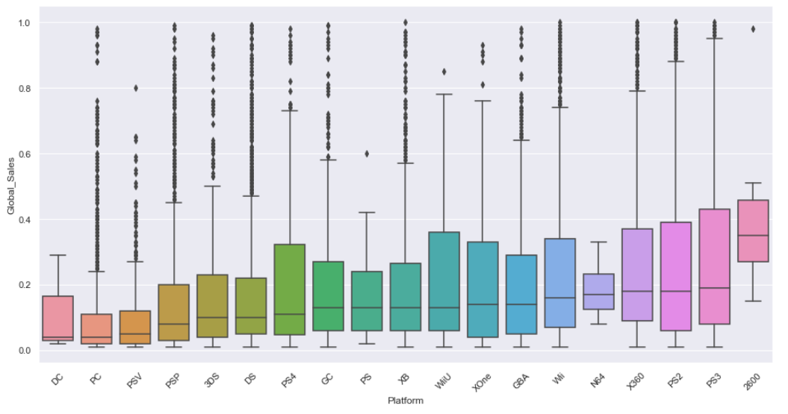
Platform VS Global Sales
Median Descending:
PS3 ≈ PS2 ≈ X360 ≈ N64 …

Slide 11
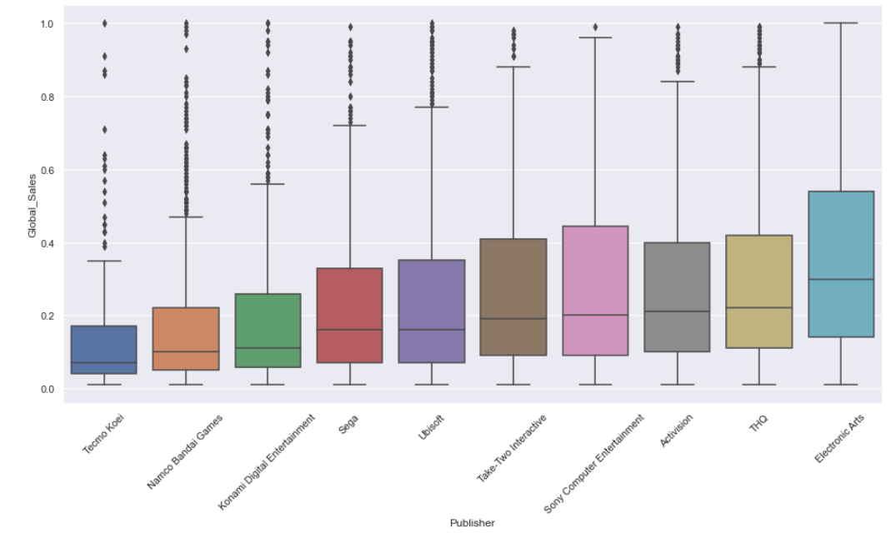
Publisher VS Global Sales
Median Descending:
Electronic Arts
THQ ≈ Activision ≈ Sony Computer Entertainment ≈ …

Slide 12
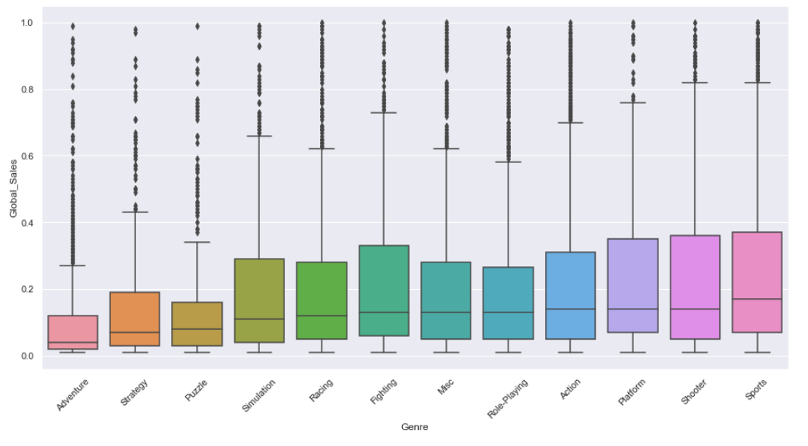
Genre VS Global Sales
Based on median values,
No outstanding genre in terms of high Global_Sales.

Slide 13
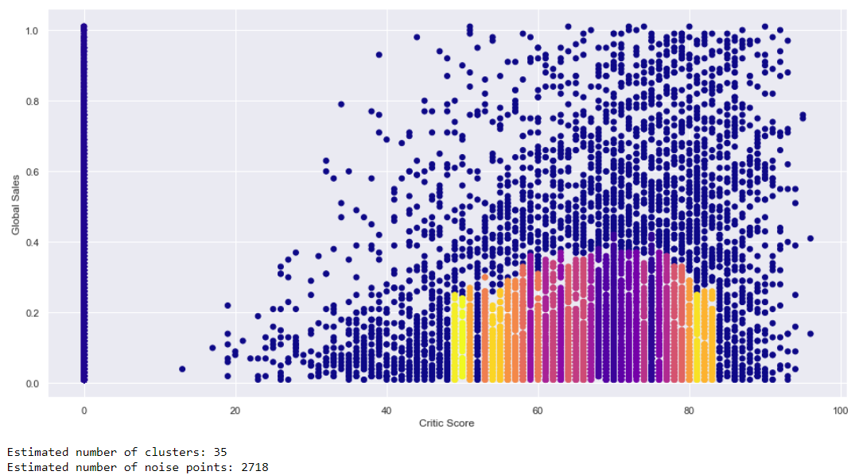
Model made using “DBScan”
CRITIC SCORE VS Global Sales
0.1 epsilon, 50 min_samples
Clusters from 50% to 85% of Critic Score
However Global Sales are ~0.4% and below
Notes:
The requirement for the cluster was set as 0.1 eps and 50min sample. As you can see, most of the clusters are from 50 to 85. However, this accounts to only 0.4% and below of sales
Epsilon, min points/samples
Blue = outliers = noise

Slide 14
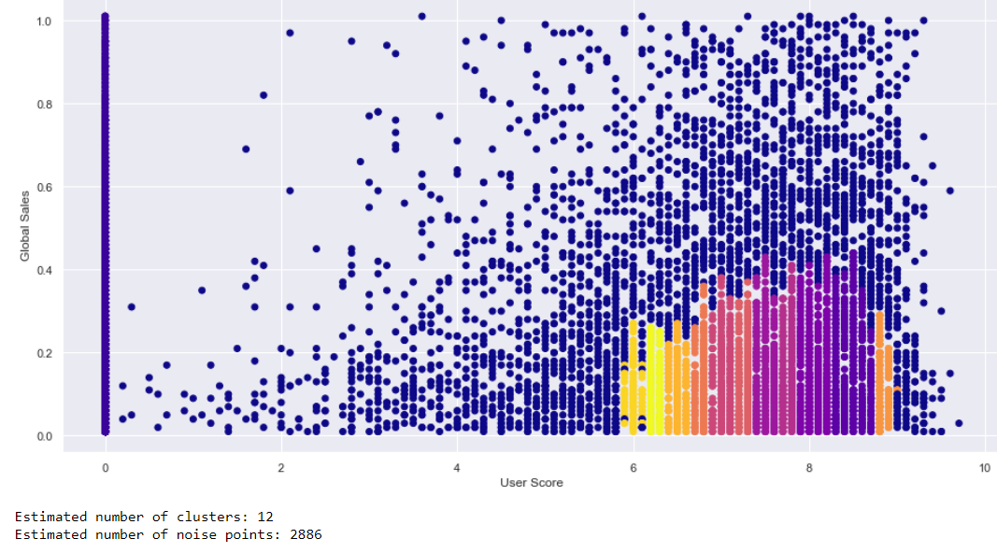
Model made using “DBScan”
USER SCORE VS Global Sales
Same setting as Critic Score
Clusters formed around User score 6 to 9
Max ~0.45% and below
Notes:
The same setting was used for user score. Clusters formed around 6 to 9, and the highest accounts for 0.45% of global sales

Slide 15
Exploratory Analysis of Variables - Observations
In order to maximize Global_Sales, we have best odds with the following choices:
Publisher: Electronic Arts
Genre : INSIGNIFICANT
Platform : PS3
Critics’ and Users’ Scores: ??
With a standard model, it is impossible to determine the correlation between Critic_Score and User_Score with Global_Sales.
→ Therefore, machine learning to determine the ‘usefulness’ of Critic & User Scores are necessary.

Slide 16
Using Machine Learning to Investigate Interrelationship Between Critic/User_Score with Global_Sales

Slide 17
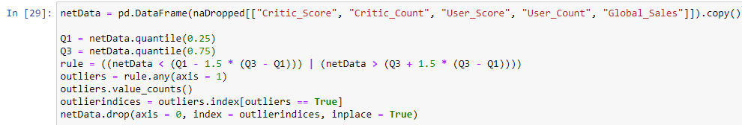
Data Preparation & Cleaning (Machine Learning)
Dropping rows with missing elements:
Removing outliers:
Concatenating new columns for reading machine learning data:

Slide 18
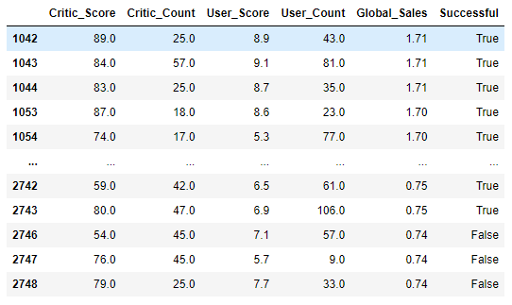
Machine Learning: Goal
*successful: top 15% for Global_Sales
Goal:
Create a machine learning algorithm that predicts whether or not a videogame will be successful* based on its Critic_Score and User_Score.
For our data, games with 0.75 Global_Sales or above are deemed to be “Successful”

Slide 19
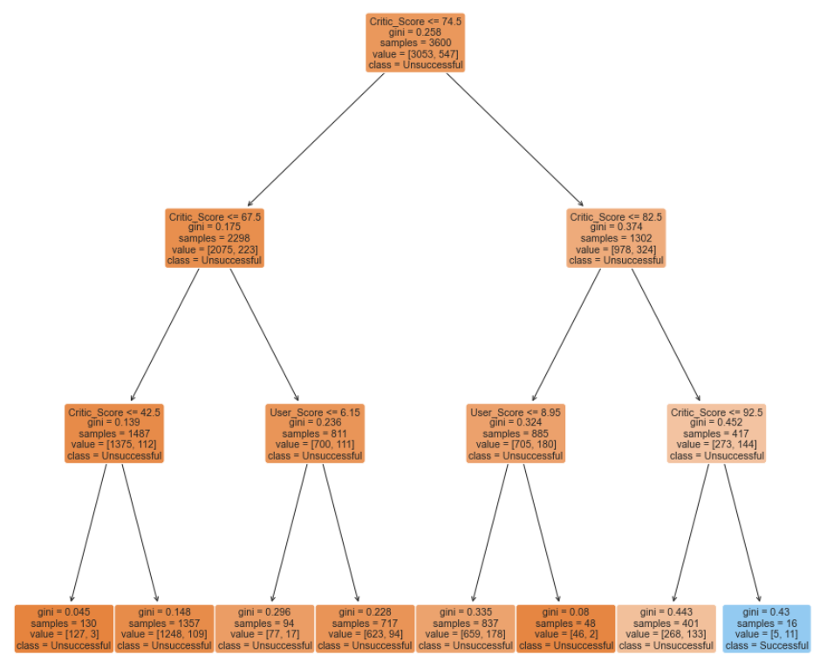

Decision Tree:
We created a decision tree with maximum depth 3.
Then we split the dataset into Train & Data sets.

Slide 20
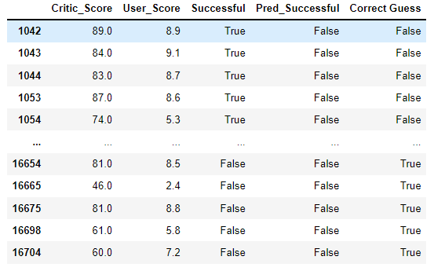
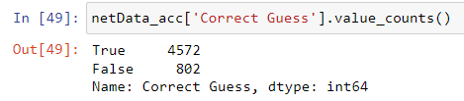
Predictions using the Classification Tree:

Slide 21
Evaluation -
Publisher: Electronic Arts
Genre: (insignificant)
Platform: PS3
Critic & User Score:
Take both into consideration
How do we make the
“best globally selling” video game?

Slide 22
DBS SCans:
Very robust to outliers
No need to input number of clusters
More about Decision Trees!
Usually handles both numerical and categorical data
scikit-learn implementation doesn’t yet support categorical
Lesson Learnt
Notes:
Unlike k-means which require specification of number of centroids.

Slide 23
Thank you!

Slide 24
https://www.analyticsvidhya.com/blog/2020/09/how-dbscan-clustering-works/
https://www.kaggle.com/datasets/gregorut/videogamesales
https://www.section.io/engineering-education/dbscan-clustering-in-python/
References
Notes:
Unlike k-means which require specification of number of centroids.

